Slide 1

Real time detection of driver drowsiness and alerting using OpenCV

Slide 2
Real time detection of driver drowsiness and alerting using OpenCV
Introduction
Our eyes are one of the primary sensing tools we use to learn and react to the environment. The field of measuring human eye movements is called eye tracking or eye detection.
In this presentation, we explain you how to detect the eye blink duration using a simple webcam with the help of python and OpenCV

Slide 3
Problem Statement :
Through this project we are focusing on the problem of automatic detection and analysis of human eye blink duration through webcam. For this OpenCV and python module are used for applying the automatic image and video processing techniques to detect the blinking eye of the human.
Methodology:
Prerequisites:
The requirements for this python project are a webcam, and python version (3.6 recommended)
Installation of below necessary packages should be done before starting the project.
OpenCV – used for face and eye detection.
Tenser flow – keras uses TensorFlow as backend.
Keras – used to build classification model.
Pygame – used to play alarm sound.
Dataset:
7000 images of people in different lighting conditions were taken and trained, the images consist of open and closed eyes.
This dataset was already trained using CNN in keras, and we got it from a public source and applied it in our source code.

Slide 4
The “haarcascade ”consists of the xml files that are needed to detect objects from the image. In our case, we are detecting the face and eyes of the person.
“cnnCat2.h5” which was the model dataset that consists of 7000 images of the people in different lighting conditions whose eyes were open and closed and this dataset was already trained using CNN in keras, and we got it from a public source and applied it in our source.
We have an audio clip “alarm.wav” which is played when the person is feeling drowsy.

Slide 5
Implementation
Step-1: We took image as input from a camera
Here webcam was used to images as input. Here we made infinite loop to access webcam which means that will capture each frame.
We used this method provided by OpenCV, cv2.VideoCapture(0) to access the camera and to set the capture object(cap), cap.read() to read each frame and stored image variable in a frame variable.

Slide 6


Step-2: We detected face in the image and created a region of interest
Here to detect the face in the image, we converted image into grayscale as we knew that in OpenCV for object detection it takes Gray images in the input. We used haar cascade classifier to detect faces.
To set our classifier we used face = cv2.CascadeClassifier(‘ path to our haar cascade xml file’). Then we performed the detection using faces = face.detectMultiScale(gray) and this returns an array of detections with coordinates (x,y), and width of the boundary box of the object, and height. So that we will be able to generate and draw boundary boxes for each face.
Step-3: We detected the eyes from region of interest and feed it to the classifier
procedure used to detect faces is used to detect eyes. We set cascade classifier for eyes in left eye(leye) and right eye(reye) respectively then detect the eyes using left_eye = leye.detectMultiScale(gray). To extract the eye data from the full image we extracted the boundary of the eye and then we pulled out the eye image form the frame using this code.

Slide 7
Step-4: classifier is used to categorize whether eyes are open or closed
Here CNN classifier is used for the prediction of the eye movement status. To feed our image and video into the model we convert the colour image into grayscale using r_eye = cv2.cvtColor(r_eye, cv2.COLOR_BGR2GRAY). Then resizing of the image was done to 24*24 pixels as our model was trained on 24*24 pixel images cv2.resize(r_eye, (24,24)).
Then we normalized the data for better convergence r_eye = r_eye/255 (all values will be between 0-1). We expand the dimensions to feed into our classifier. Loaded our model using model = load_model(‘models/cnnCat2.h5’). then we predicted each eye with our model lpred = model.predict_classes(l_eye). If the value of lpred[0] = 1, it states that eyes or open, if value of lpred[0] = 0 then, it states that eyes are closed.
Step-5: we calculated score to check whether person is drowsy
score is basically a value used to determine how long the person has closed his eyes. If both eyes are closed, then we will keep on increase the score and when eyes are open, we decrease the score.
The result is drawn on the screen using cv2.putText() function which display real time status of the person.
A threshold is defined for example if score becomes greater than 15 that means the person’s eyes are closed for a long period of time. This is when the alarm beep will played using sound.play()

Slide 8
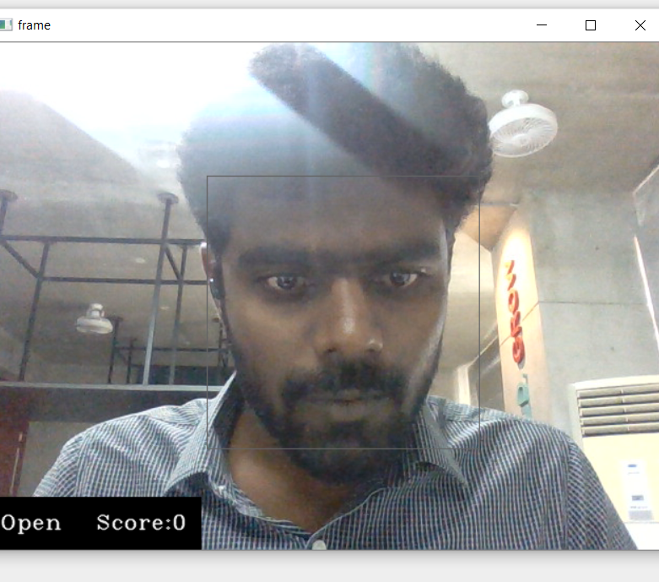
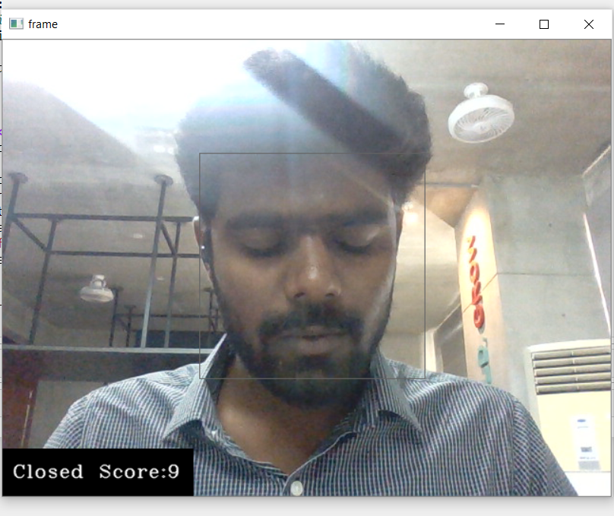
Results:
Open eye Closed eye

Slide 9
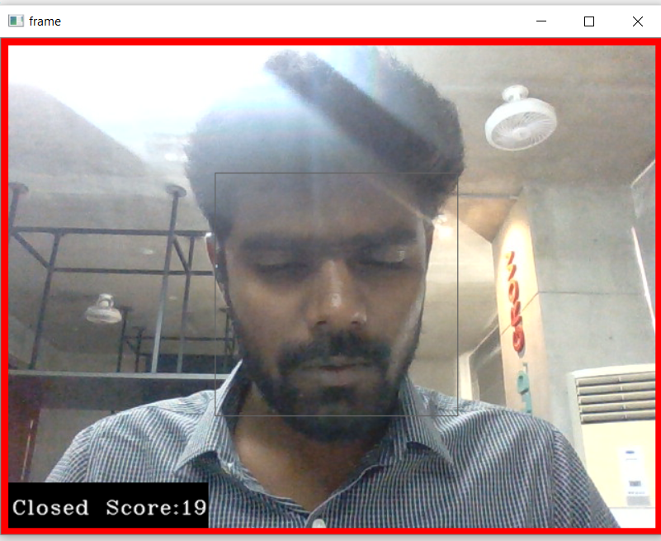
Sleep alert:

Slide 10
References:
Real Time Eye Blinking Detection and Tracking Using OpenCV:
https://www.researchgate.net/publication/272172830_Real_Time_Eye_Blinking_Detection_and_Tracking_Using_Opencv

Slide 11
